Slide 1
Super Mario Bros AI
Joshua Pauly
DAAN 572 reinforcement learning(Spring, 2023)

Slide 2

Problem Statement
The speed running community is still a large community for the original super Mario game. However, the top speed running record for completion of the game is held by an AI with a record of 4mins and 54.26 sec.
Create a Super Mario Bro AI agent

Slide 3
Environment
Environment: Open AI Gym Super Mario Bros NES game
Agent: Mario (controllable character)
Actions: Mario can make simple movements created for us within the open AI environment as a function JoypadSpace.
States: Level complete (touching flag pole), loss of life (falling to death / hit by enemy), Skipping level/s(going down a pipe and changing worlds / levels), Goal State (Saving Princess peach), Game Over State (Running out of lives)
State is a single frame of mario
Rewards: move right(+) move left(-) end game(--) complete level(++)

Slide 4
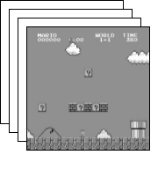
Preprocessing
Wrap the environment to change what data is fed to the AI algorithm
2 main preprocessing techniques:
Gray Scale
Frame Stacking (4 frames)

Slide 5
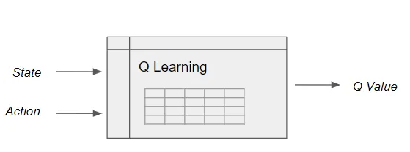
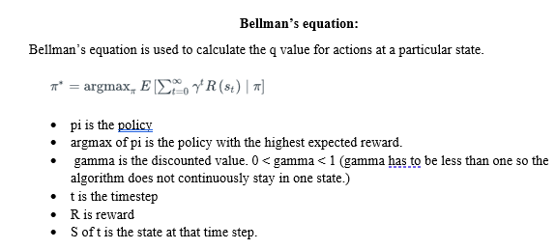
Q learning

Slide 6
Advantages of DQN
With such a large state space I implemented DQN so that not all states have to be explored whereas Q learning would require the exploration of all states to find optimal policy.
Neural network is applied to estimate the Q function

Slide 7
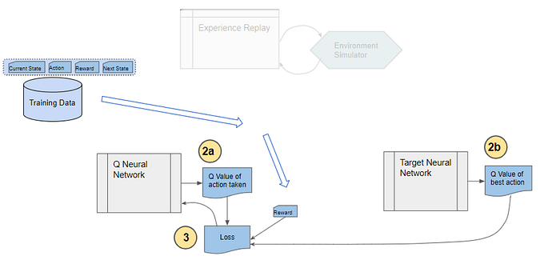
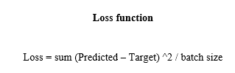
DQN Architecture

Slide 8
DQN settings
Learning rate 0.0015
Memory size 30000
Batch size 32
Discount factor 0.9995
Drop out of 0.2
Max exploration 1%
Exploration minimum 0.001%
Exploration decay 99%

Slide 9
DQN Controlled Mario
Trained the DQN network on 3000 episodes ~16hrs.
Episodes are completed when Mario loses his life

Slide 10
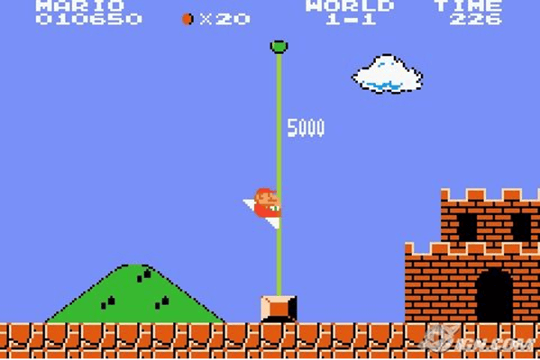
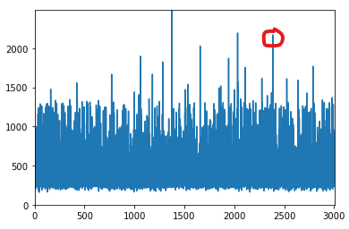
Results
1 observed level completion estimating only 3 completions or 0.1%

Slide 11
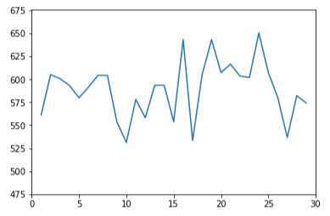
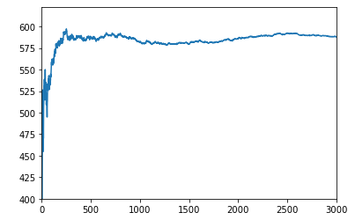
Results Cont.
100-episode bucket average reward
Running average rewards by episode

Slide 12
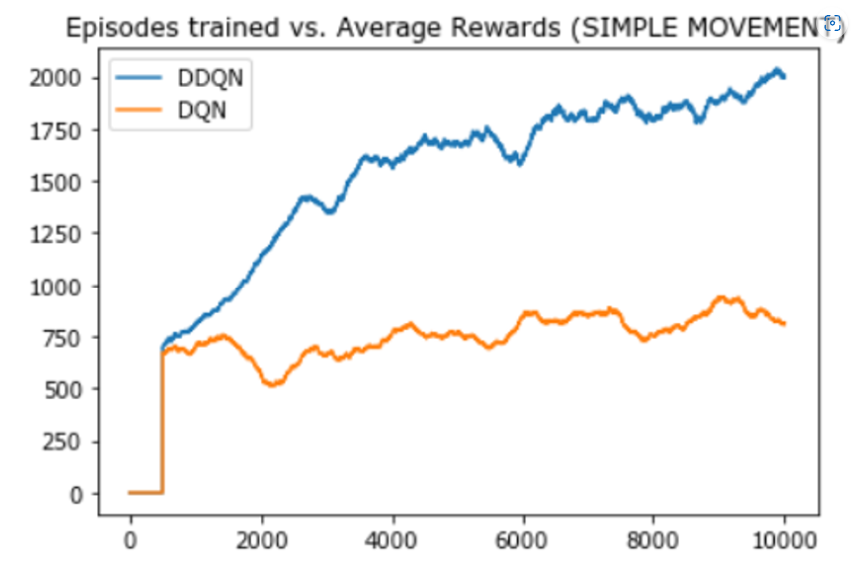
Future Changes
Implementing a DDQN
Uses a second neural network to update the weights through back propagation
Solves overestimating the Q target value which was my limiting factor in my project.
(Chao, D.-Y. (2021, June 11))

Slide 13
Works Cited
Wojnar, J. (2022, August 20). Every mario platformer ranked by how long they take to beat. Game Rant. Retrieved March 19, 2023, from https://gamerant.com/new-mario-platformers-length-howlongtobeat-super-bros/#super-mario-bros-2-hours
Super Mario Bros.. speedrun.com. (n.d.). Retrieved March 19, 2023, from https://www.speedrun.com/smb1?h=Any-NTSC&x=w20p0zkn-onvvdymn.013zwgxq
Fastest completion of Super Mario Bros. (any%). Guinness World Records. (n.d.). Retrieved March 19, 2023, from https://www.guinnessworldrecords.com/world-records/105579-fastest-completion-of-super-mario-bros#:~:text=The%20tool%2Dassisted%20(TAS),from%20the%20best%20run%20possible.
Krishnakumar, M. (2023, January 8). A gentle introduction to Openai Gym. W&B. Retrieved March 19, 2023, from https://wandb.ai/mukilan/intro_to_gym/reports/A-Gentle-Introduction-to-OpenAI-Gym--VmlldzozMjg5MTA3
YouTube. (2021). Build an Mario Ai Model with Python | Gaming Reinforcement Learning. YouTube. Retrieved March 26, 2023, from https://www.youtube.com/watch?v=2eeYqJ0uBKE&ab_channel=NicholasRenotte.
Chao, D.-Y. (2021, June 11). Playing super Mario Bros with deep reinforcement learning. Analytics Vidhya. Retrieved April 28, 2023, from https://www.analyticsvidhya.com/blog/2021/06/playing-super-mario-bros-with-deep-reinforcement-learning/
Doshi, K. (2021, February 14). Reinforcement learning explained visually (part 5): Deep Q Networks, step-by-step. Medium. Retrieved April 28, 2023, from https://towardsdatascience.com/reinforcement-learning-explained-visually-part-5-deep-q-networks-step-by-step-5a5317197f4b

Slide 14
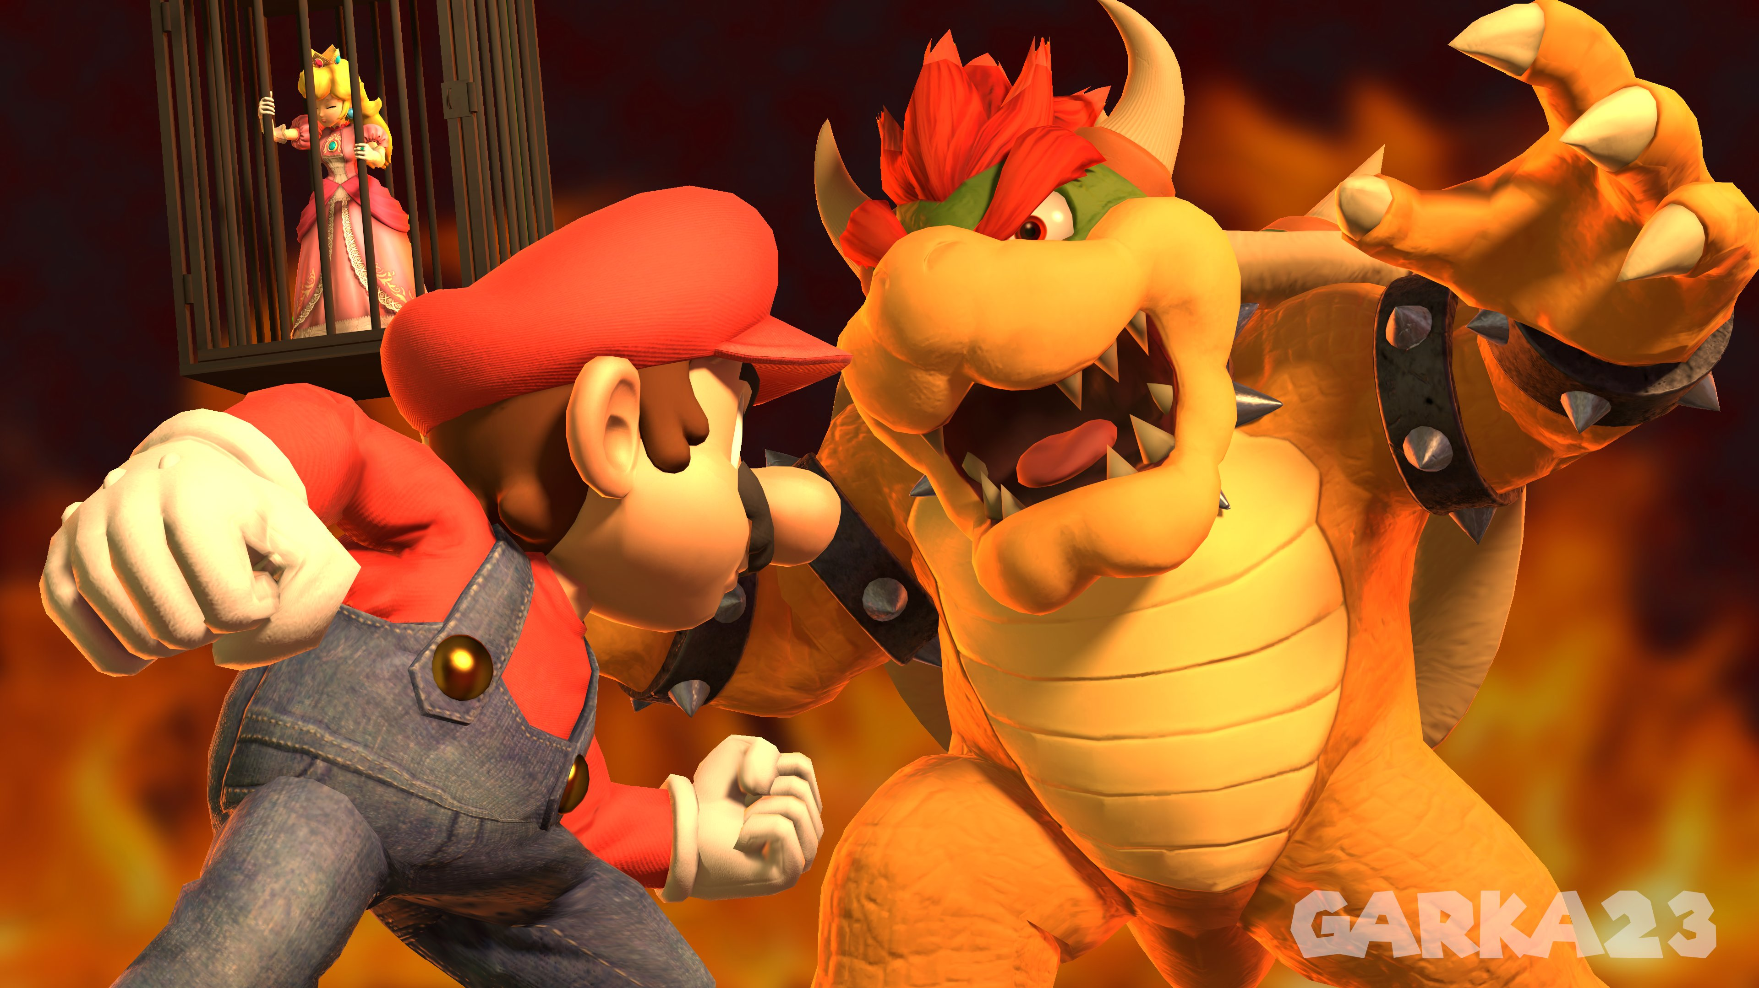
Thank you!

